Slide 1
Module 4

Slide 2
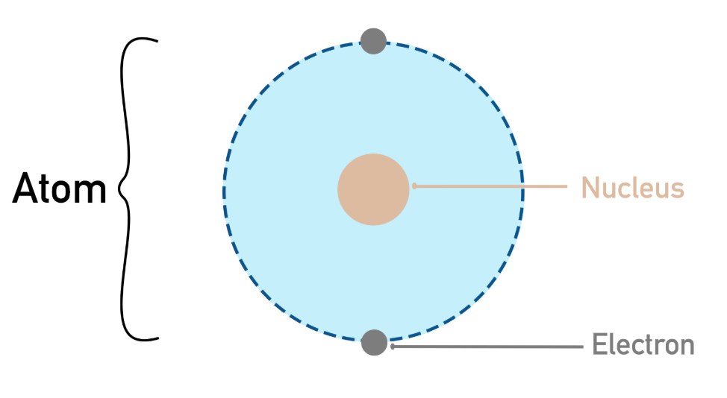
Atoms
Everything is made of atoms
Inside an atom: Center → nucleus Around it → electrons
Electrons in the outermost shell (valence electrons) are important These electrons can move or participate in conduction
An electron is a tiny particle with negative charge (–). It can move from one place to another
When an electron leaves its position it leaves an empty space. That empty space is called a Hole
Hole is not a real particle. It is just a missing electron.
Electrons move → actual particles moving, Holes move → empty spaces shifting, Both contribute to current
A semiconductor is a material where Current does not flow easily (like metal) But can flow when energy is given.
Electrons are tightly bound in bonds. When energy (heat/light) is given: Electrons become free and Holes are created

Slide 3
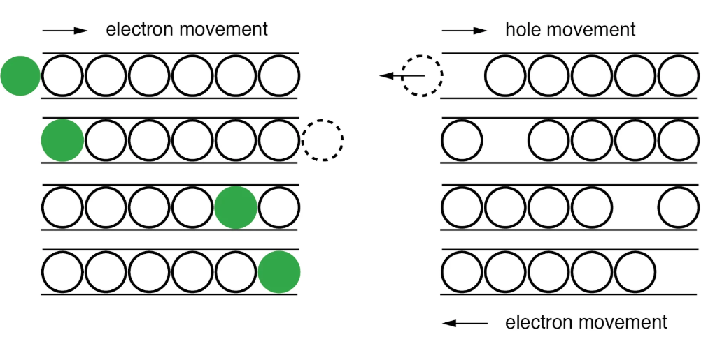

Slide 4
What happens when P and N join?
N side → many electrons
P side → many holes
so
Electrons move to P side
Holes move to N side
They meet and recombine.So near the junction: No free electrons and No free holes. This creates: Depletion Region
In depletion region On one side → positive fixed ions (from N-side donors) and On the other side → negative fixed ions (from P-side acceptors). Positive charges and negative charges are separated This creates a potential difference
Reverse Bias means P side connected to negative terminal and N side connected to positive terminal
Electrons are pulled away from junction. Holes are also pulled away so Depletion region becomes wider as a result Electric field becomes stronger
Ideally: No current should flow But practically: A very small current flows:Reverse Saturation Current

Slide 5
Photodiode
A photodiode is a light-sensitive semiconductor device that converts light into electrical current.
A photodiode is a PN junction semiconductor device
It is always operated in reverse bias
Reverse bias means: P-side → connected to negative and N-side → connected to positive
When reverse bias is applied: Depletion Region Formation happens
The junction region becomes wide. No free charge carriers exist here
A strong electric field is created across the junction . This electric field is the key to photodiode operation

Slide 6
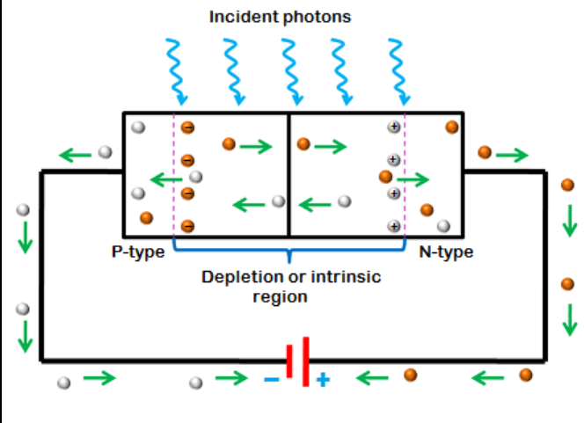

Slide 7
In Darkness (No Light)
No external photons → no extra carriers generated.Only a very small current flows called: Dark current (reverse saturation current) it is due to thermally generated electron-hole pairs.
When Light Falls on Photodiode
Step 1: Photon Absorption
Light energy (photons) enters the depletion region. If photon energy is sufficient:
hν≥Eg (where Eg​ = band gap energy)
Then: An electron-hole pair (EHP) is generated
Step 2: Separation of Charges
Because of the electric field in depletion region: Electron → pulled towards N-side and Hole → pulled towards P-side
This happens very fast and No recombination occurs
Step 3: Flow of Current
Movement of electrons and holes creates a current. This current is called:Photocurrent (Iₚ)

Slide 8
Total current in photodiode: I=Idark+Iphoto
Where:
Idark = dark current (very small)
Iphoto_​ = photocurrent
Since Idark ​ is small: I≈Iphoto​
More light → more photons → more EHP → more current
Less light → less current

Slide 9
photoresistor = Light Dependent Resistor (LDR)(module 2)

Slide 10
Parameter | Photoresistor (LDR) | Photodiode
Sensitivity | High | Moderate
Response Time | Very slow (ms to seconds) | Very fast (nanoseconds)
Applications | automatic lighting | Optical communication

Slide 11
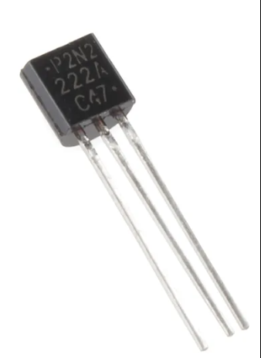
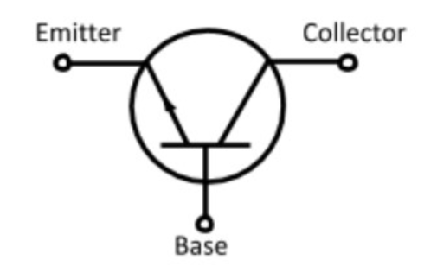
Transistor
A transistor is a device used to control current.
It has 3 parts:
Emitter (E)
Base (B)
Collector (C)
Base is very thin, Emitter is heavily doped & Collector is moderately doped
Without Base Current no current into base so Transistor is OFF and No current from collector to emitter
With Small Base Current
Small current enters base so Large current flows from collector to emitter
IC​=β×IB​

Slide 12
Phototransistor
A phototransistor is a light-sensitive transistor in which incident light generates base current, resulting in an amplified collector current proportional to light intensity
Light generates the base current
In Darkness
No light → no base current so Transistor is OFF i.e Only very small leakage current
When Light Falls
Step 1: Generation of carriers
Light falls on base-collector junction. Creates electron–hole pairs
Step 2: Base current formation
These carriers act like a base current (I_B)
Step 3: Current amplification
IC=β×IB
Small base current gets amplified and Large collector current (I_C) flows
Step 4: Output voltage
Current flows through resistor RC
Vout=Vcc−ICRC
More light → more current → change in output voltage

Slide 13
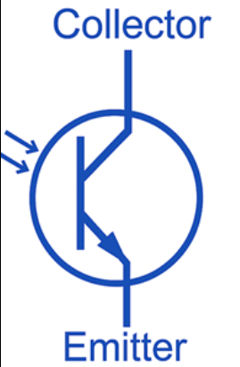
Key Characteristics
High Sensitivity
More sensitive than photodiode (due to gain)
Slower Response
Slower than photodiode (due to charge storage)
Nonlinear Output
Output not perfectly proportional to light
Common Applications
Light Sensors
Automatic street lights
Security Systems
Intrusion detection

Slide 14
Photoelectric Effect
First, light falls on a metal surface. This metal surface contains electrons inside it.
Light is made of small energy packets called photons. When these photons hit the metal, they give their energy to the electrons present in the metal.
If the energy of the light is high enough, the electrons will get enough energy to escape from the metal surface. This process is called the photoelectric effect.
If the light energy is low, electrons will not come out, even if the light is very bright. So, the frequency (energy) of light is more important than intensity.
When more light falls, more electrons are emitted. So:
More light → more electrons
Less light → fewer electrons

Slide 15
Significance of Photoelectric Effect in Photovoltaic Sensors
Photovoltaic sensors, such as solar cells, work based on the photoelectric effect, which helps in converting light energy into electrical energy.
When light falls on the sensor material (usually silicon), the energy from the light is absorbed. Due to this, electrons get excited and electron–hole pairs are generated.
These electrons and holes are separated by the internal electric field present inside the sensor. As a result, electrons move in one direction and holes move in the opposite direction.
This movement of charges produces an electric current and also creates a voltage across the device.
Thus, the sensor converts light energy directly into electrical energy without using any external power supply.

Slide 16
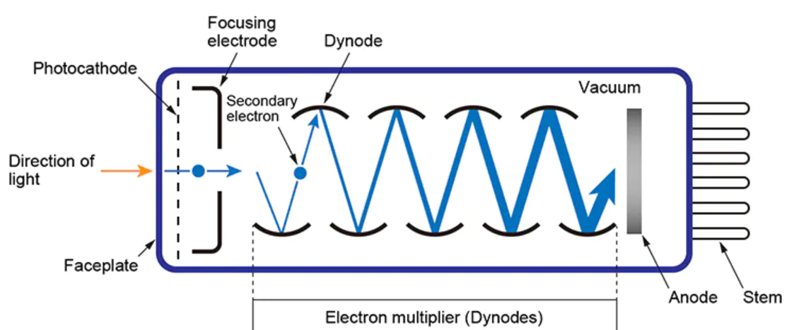
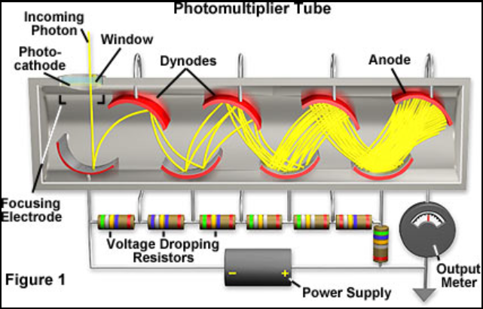
Photomultiplier Tube (PMT)
A Photomultiplier Tube (PMT) is an extremely sensitive light detector that can detect even a single photon by amplifying it into a measurable electrical signal.

Slide 17
First, light enters the photomultiplier tube and falls on a light-sensitive metal surface called the photocathode. The photocathode works on the principle of the photoelectric effect, which means that when light falls on it, it emits electrons .
The emission of electrons depends on the intensity of the incident light. If the light intensity is high, more electrons are emitted, and if the light intensity is low, fewer electrons are emitted. However, these emitted electrons are very weak and are present in a small quantity.
To increase their energy, a high voltage is applied inside the tube. Due to this applied voltage, the emitted electrons are accelerated and made to travel at high speed toward the first dynode.
The dynodes are a series of metal plates arranged inside the tube, each maintained at a progressively higher voltage. The main function of dynodes is electron multiplication.
When a high-speed electron strikes the first dynode, it releases multiple secondary electrons. This process is called secondary emission. For example, one electron may produce two or more electrons after striking a dynode.
These newly generated electrons are again accelerated toward the next dynode, where further multiplication occurs. This process continues through multiple dynodes, resulting in a large number of electrons. Thus, at each stage, the number of electrons increases, leading to exponential amplification.

Slide 18
To achieve high amplification, multiple dynodes are used in the tube. The more the number of dynodes, the greater will be the multiplication of electrons.
Finally, all the multiplied electrons reach the anode, which is the output electrode of the photomultiplier tube. The anode collects these electrons and converts them into an electrical current.
Thus, a very weak input light signal is converted into a strong electrical signal at the output. In other words, the photomultiplier tube amplifies weak light signals into measurable electrical signals.

Slide 19
Key Features
Extremely high sensitivity (detects single photons)
Fast response time (nanoseconds)
Low noise
Common Applications
Medical & Biomedical
PET scanners (Positron Emission Tomography)
Scientific Research
Nuclear radiation detection
Astronomy
Detection of faint light from stars and galaxies

Slide 20
Parameter | Photodiode | Phototransistor | Photomultiplier Tube (PMT)
Sensitivity | Low to moderate | Moderate to high | Extremely high
Response Time | Very fast (nanoseconds) | Slower (microseconds) | Very fast (nanoseconds)
Applications | Optical communication, light sensing | Switching, object detection, IR sensors | Medical imaging, spectroscopy, astronomy

Slide 21
Self-Generating Sensors
Self-generating sensors are sensors that produce their own electrical output signal directly from the physical quantity being measured, without the need for any external power supply.
In these sensors, the input energy such as light, heat, or pressure is directly converted into electrical energy. This means the sensor itself generates voltage or current when it is exposed to the physical quantity.
For example, in a thermocouple, heat is converted into voltage; in a piezoelectric sensor, pressure is converted into electrical signal; and in a photovoltaic cell, light is converted into current.

Slide 22
Self-Generating Sensor advantages over Externally Powered Sensors
1. No External Power Required
They do not need batteries or power supply, so the system becomes simple.
2. Suitable for Remote Locations
Can be used in places where power supply is not available.
3. Simple and Compact Design
Less circuitry is required, making the system smaller and easier to maintain.
4. High Reliability
Since fewer components are used, chances of failure are less.
5. Energy Efficient
They use the input energy itself, so no extra energy is consumed.

Slide 23
Thermoelectric Effects
Thermoelectric effects are the phenomena in which heat (temperature difference) and electrical energy are directly converted into each other.
That means:
A temperature difference can produce electricity
Or electricity can produce heating or cooling
Thermoelectric effect is a general concept.
Inside this concept, there are three different ways energy conversion can happen:
Seebeck effect → Temperature difference produces voltage
Peltier effect → Current produces heating/cooling
Thomson effect → Current + temperature difference causes heat absorption/release

Slide 24
Seebeck Effect
The Seebeck effect occurs when two different metals are joined together to form a closed circuit, and their junctions are kept at different temperatures.
Because of this temperature difference, electrons start moving from the hot region to the cold region, which creates a voltage (emf) in the circuit.
Peltier Effect
The Peltier effect is the opposite of the Seebeck effect.
When an electric current is passed through the junction of two different materials, heat is either absorbed or released at the junction.
This means one side becomes cooler, and the other side becomes hotter.
When current flows, it causes heating at one junction and cooling at the other.

Slide 25
Thomson Effect
The Thomson effect occurs in a single conductor when there is both electric current and a temperature difference along it.
Due to this, heat is either absorbed or released continuously along the length of the conductor.
When current flows in a conductor with temperature difference, extra heating or cooling happens inside the conductor.
Role in Thermoelectric Sensors
Thermoelectric sensors, such as thermocouples, mainly use the Seebeck effect.
When there is a temperature difference between two junctions, a voltage is produced
This voltage is directly related to temperature, so it can be used to measure temperature
The Peltier and Thomson effects help in understanding heat transfer inside the sensor and improve accuracy

